Slide 1
Data Science Project
Presented by :
Suvraneel Das

Slide 2
PREPARING AN ML MODEL TO PREDICT PROFIT
R&D SPEND, Administrative cost and Marketing spend OF 50 COMPANIES ARE GIVEN. BASED UPON THAT N Machine learning model needs to be prepared which can predict maximum profit.

Slide 3
CONTENT
1.Abstract
2. Introduction
3. Objective
4. Existing Method
5. Proposed method
6. System architecture
6. Methodology & Explanation
7. Final Score
8. Conclusion

Slide 4
ABSTRACT
A machine learning model is a mathematical representation of objects and their relationships to each other. They are fueled by data & by discovering patterns within the training data it outputs an ML model which captures these patterns and makes prediction on new data.
This project provides an overview of an ML model that predicts the profit value of a company based on R&D spend, administrative cost and marketing spend.
This projects shows the use of data, how it’s processed before training & how predicted outcome can be achieved.
It also demonstrates the usefulness of ML models in predicting business outcomes and can be useful for business owners and investors in making important decisions.

Slide 5
INTRODUCTION
A profit prediction project is a machine learning project that aims to predict the profit of a company based on various factors such as R&D spend, administration cost and marketing spend, generated by the company.
This project involves training a machine learning model on a dataset that contains information about the various factors that affect the profit of a company.
Three input(independent) variables are given : R&D spend, Administration cost and Marketing spend
One output(dependent) variable is: Profit
For this, I used various regression models and comparing the values (R-squared-score, Mean-absolute-error & Mean-squared-error) I chose the best model for my project.
The model is then used to predict the profit of a new company based on its characteristics.

Slide 6
OBJECTIVE
To build ML models based on dependent and independent variables
to predict the profit of a company based on various factors such as R&D spend, administration cost and marketing spend generated by the company.
To maximize the profit
To generate the best ML model for this purpose.
Additionally, the object is to create a user friendly solution that can easily be adopted by various business industries.

Slide 7
EXISTING METHOD
At present, many of the systems in business industries may rely on manual calculations or basic statistical techniques to predict profit that may not accurately capture complex algorithms and big data.
Disadvantages of existing method:
Limited accuracy
Overfitting and underfitting
Time consuming
Limited scope
Complex

Slide 8
PROPOSED SYSTEM
The proposed system is an ML model that utilizes regression algorithm to predict the profit value of a company based on R&D spend, administrative cost and marketing spend.
It addresses the drawbacks of existing methods by incorporating a more accurate and efficient algorithm for profit prediction.
The model is also prepared to reuse as many times as possible.
Advantages of proposed system:
Increased accuracy
Improved performance
Easy to implement
Cost effective
Reusability

Slide 9
SYSTEM ARCHITECTURE
Data Collection
Data Import
Data Preprocessing
Data Splitting into Training and Testing Sets
Model Selection
Model Training
Model Evaluation
Choosing Best Fit Model
Model Deployment

Slide 10
EXPLANATION
R&D SPEND, Administrative cost and Marketing spend OF 50 companies are given. Based on that an ML model needs to be prepared which can predict maximum profit.
So, Three input(independent) variables are given : R&D spend, Administration cost and Marketing spend.
One output(dependent) variable is: Profit.
Models that are used in this project is : Linear Regression, Decision Tree, Random Forest, Ridge and Lasso Regression, Elastic net, Support Vector Regression & XGBoost

Slide 11
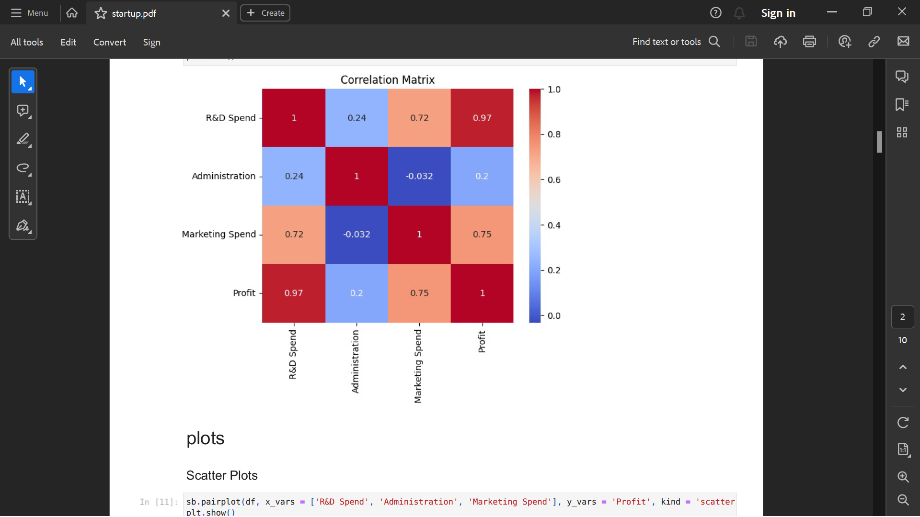
X variables are : R&D spend, Administration cost and Marketing spend. Y variable is : Profit Heatmap Representation:

Slide 12
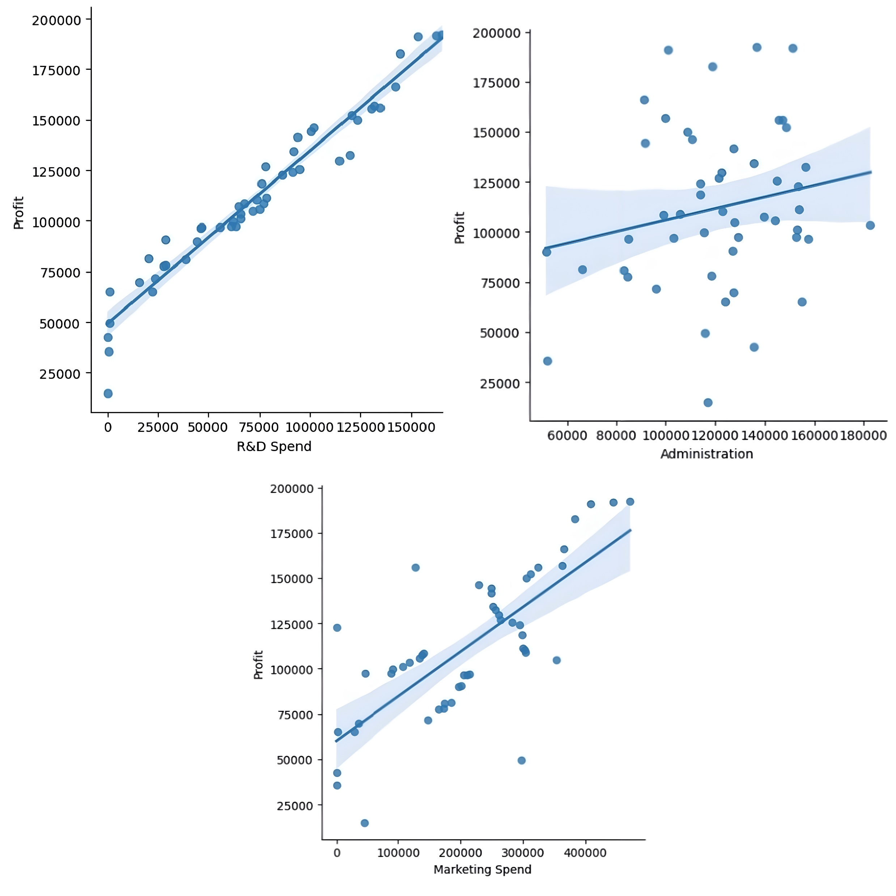
X variables are : R&D spend, Administration cost and Marketing spend. Y variable is : Profit Regression lines can be drawn like below:

Slide 13
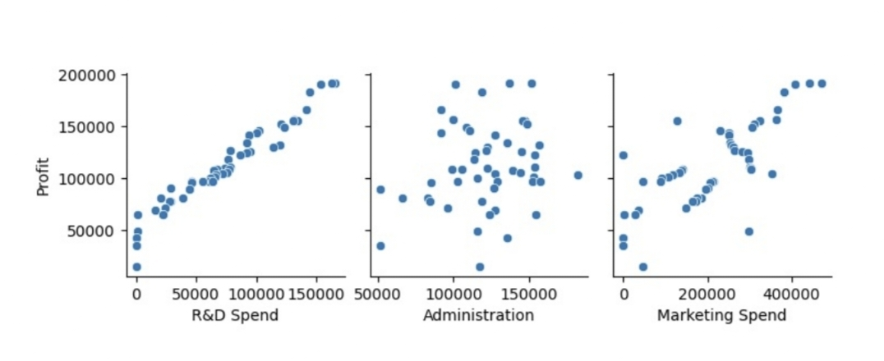
X variables are : R&D spend, Administration cost and Marketing spend. Y variable is : Profit Scatter plots are:

Slide 14
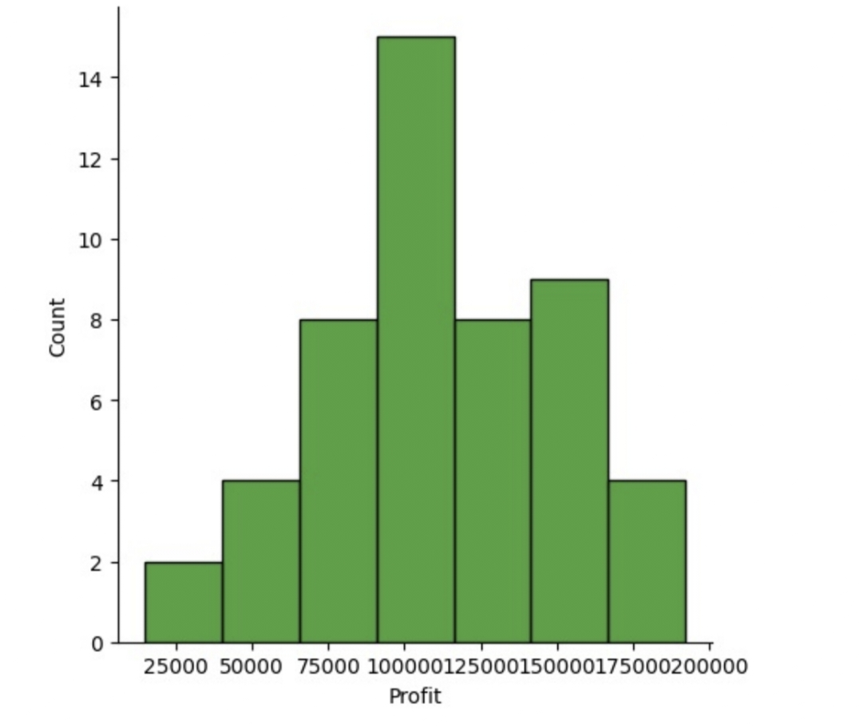
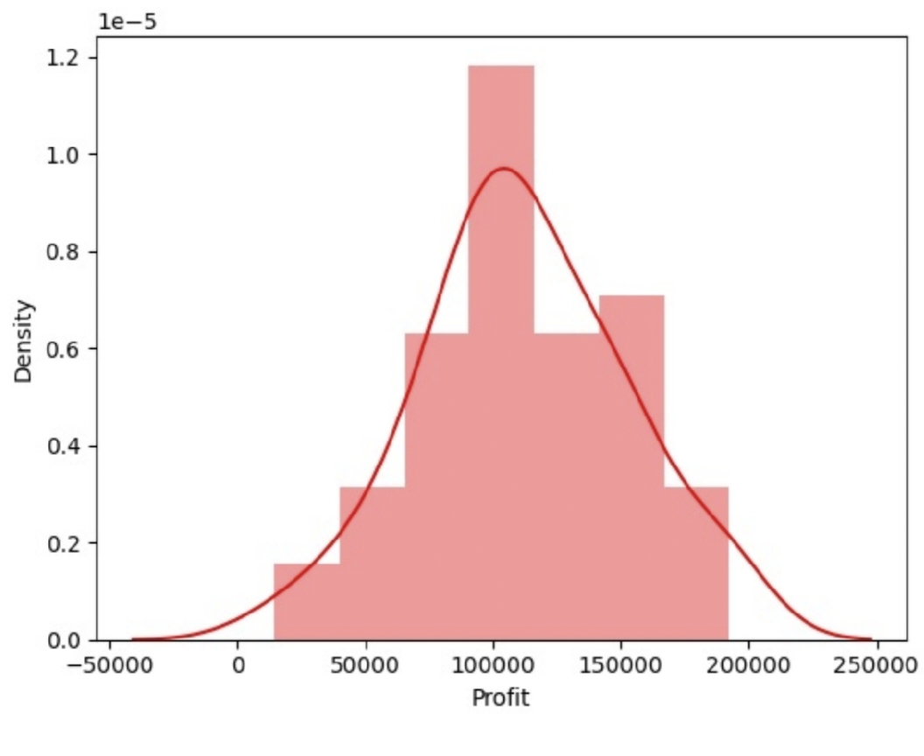
X variables are : R&D spend, Administration cost and Marketing spend. Y variable is : Profit Histogram and Distribution plots are:

Slide 15
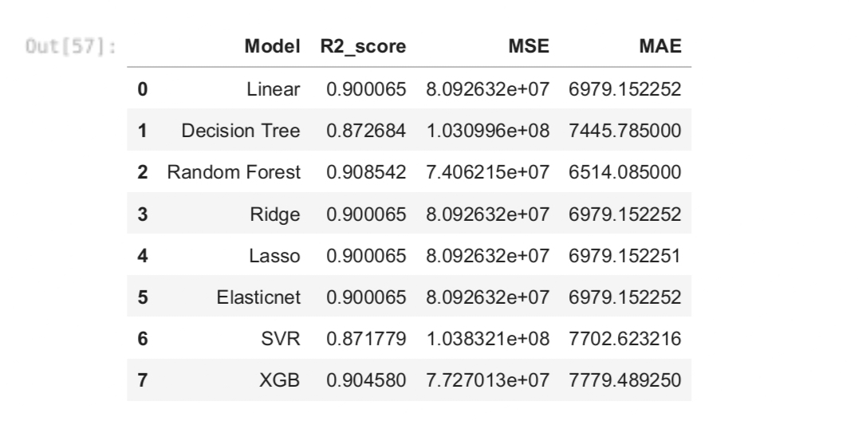
Here I calculated R Squared Score, Mean Absolute Error (MAE) & Mean Squared Error (MSE). Scores are shown below for each model:

Slide 16
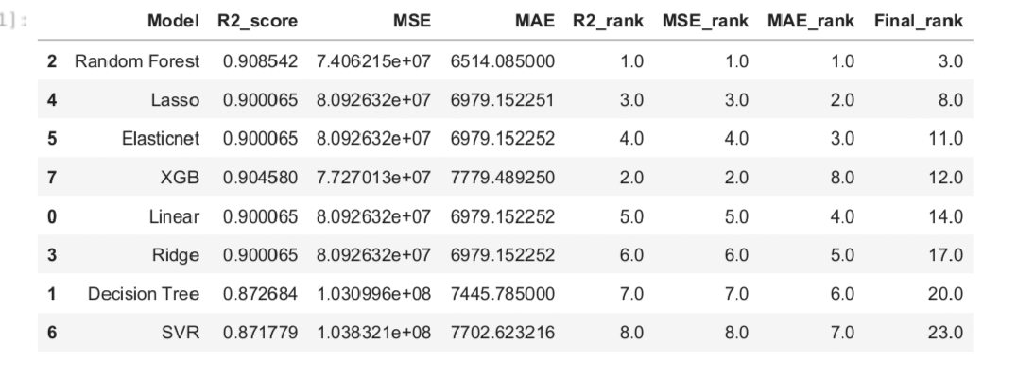
The lower value of MAE & MSE implies higher accuracy of a regression model. However, a higher value of R square is considered desirable. According to the algorithm used in this project, The lower the final rank the better the model is. Final rank is shown below :

Slide 17
CONCLUSION
After training different models and testing output data, I came to a conclusion that Random Forest Regression is the best regression model for calculating profit based on given data.
Random Forest is an ensemble technique capable of performing both regression and classification tasks with the use of multiple decision trees. It has multiple decision trees as base learning models. We randomly perform row sampling and feature sampling from the dataset forming sample datasets for every model. This part is called Bootstrap.

Slide 18
THANK YOU

